Slide 1
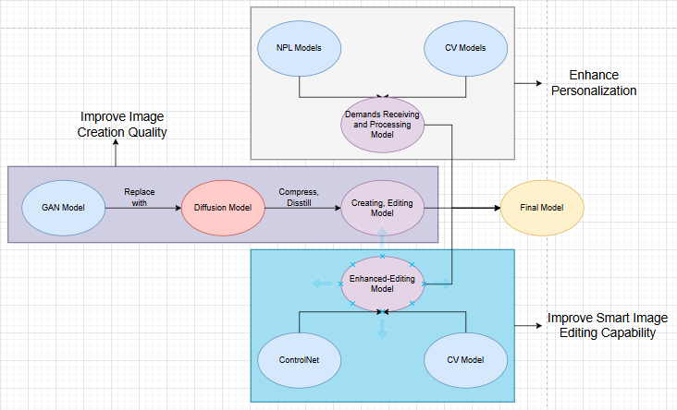

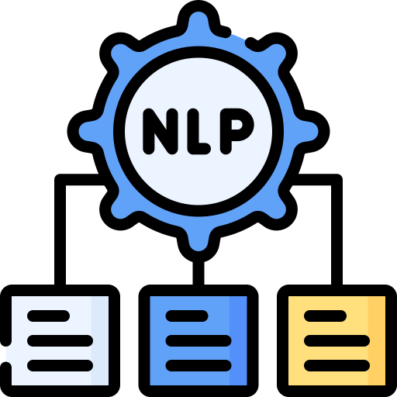


RESEARCH AND IMPROVE A.I IN CREATING AND EDITING IMAGES ON DEMANDS
Vũ Duy Hải ¹
¹ University of Infomation Technology
UIT, Vietnam
What is A.I art ?
Why to research and improve it ?
AI art refers to artworks created with the assistance of artificial intelligence technologies, where algorithms generate, modify, or enhance visual content based on specific inputs from the user. This innovative field blends creativity and computational techniques, resulting in unique and often surprising outputs.
You can find many AI art apps or webs on the internet nowadays. These apps and webs are still good, but somtimes they can not meet your demands even though we provide them with complete information. So, we are here doing the many researchs to find out a better way to create and operate an AI art app/web, which makes everyone feel please about whatever it produces.
Overview
- Improve Image Creation Quality
- Enhance Personalization
- Impove Smart Image Editing Capability
Description
Improve Image Creation Quality
GAN Models are used a lot in current image creation websites and apps.
Disadvantages of GAN: imbalance between generator and discriminator leads to "mode collapse".
Diffusion Models overcomes this situation, capable of creating images with higher resolution.
=> Replace GAN Model with Diffusion Model.
Disadvantages of Diffusion: quite high computational cost and requires a lot of training resources.
=> Use compression and distillation technique to minimize model and increase it’s speed.
Enhance Personalization
Research and combine natural language processing (NLP) models with computer vision (CV) to better understand user’s demands.
Improve the model, compare performance to choose the best model, based on customer satisfaction level, or own satisfaction level during the experiment.
Impove Smart Image Editing Capability
Uses a controlled adversarial neural network (ControlNet) to fine-tune specific features in an image.
Improve the computer vision (CV) model to more clearly distinguish components, objects, etc. in images (including real photos, gothic anime style,...) to facilitate work edit.
Tên tác giả chính– Trường Đại học
TEL : ********* Email : *********

